Slide 1
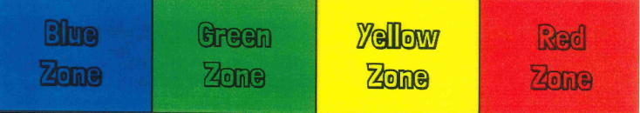
The ZONES of Regulation®
Notes:
categorizes all the different ways we feel and states of alertness into 4 colors. Creating this type of system to categorize the complex feelings and emotions improves their ability to recognize and communicate how they're feeling in a safe, non-judgmental way.

Slide 2
Why teach the ZONES of Regulation®?
It gives students, teachers, and parents a common language to discuss emotions.
The Zones of Regulation are simple for individuals to understand.
Typically, children who can self-regulate will turn into teens who can self-regulate.
Understanding the emotions of others helps with empathy and friendship skills.

Slide 3
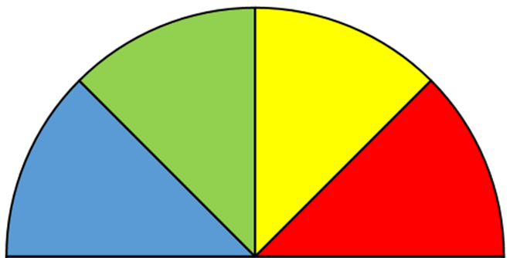
What does Zone of Regulation mean?
Your body and brain have energy. Your energy level change depending on how you feel or what you’re doing. Think about your energy level as being in different ZONES.
Blue Zone – Body running slow, such as when tired, sick, sad, or bored
Green Zone – Like a green light , “Good to Go!”. Being in the Green Zone shows control.
Yellow Zone – Proceed with Caution & Slow Down! A person has some control when in the Yellow Zone
Red Zone – Extreme Emotions! out of control, trouble making good decisions, and must STOP

Slide 4
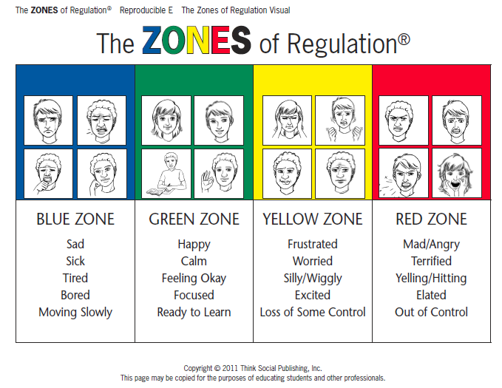

Slide 5
Emotions:
Have a purpose. These messages are supposed to bring our attention to important things that are happening in our lives; whether it is a big event (e.g. the birth of a child), or something smaller and more day-to-day (e.g. getting a parking ticket).
These emotion messages get through to us in three different ways, through
➢ our body (physical sensations)
➢ our minds (thoughts, memories, imagination)
➢ our behaviour (urges and actions)
All emotions have a helpful role to play, though they can be pleasant or unpleasant.

Slide 6
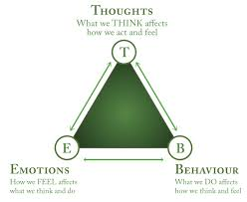
-

Slide 7
Recognizing emotions is the first step to regulating them
How does your body tell you you’re getting..
Tired?
Stressed?
Frustrated?
Calm?
What clues can we look for to know what zone someone is in?

Slide 8
The Zones of Regulation is a simple idea that says we all have a comfort zone where we can manage our emotions productively, based on how intense the emotion is.

Slide 9
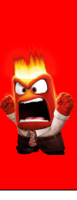
Red Zone: When our emotions are too intense then we may feel panicked, distraught, “hyper” or overwhelmed. When our emotions are too intense it is very difficult to slow down, take stock of what we are feeling, and to act on those emotions in healthy ways. So we tend to react impulsively, without thinking about the consequences.

Slide 10
Validate feelings - There is no such thing as a bad ZONE.
Everyone experiences all of the Zones—the Red and Yellow Zones are not “naughty” zones. (e.g., “It’s totally okay to feel angry, but it’s not okay to hit”)
UNEXPECTED RED ZONE TIP
Limit verbals – This is not a teachable moment.
Validate their feelings.
Give them time and space.
Process and teach skills later when calm.

Slide 11
Strategies at Silver End …

Slide 12
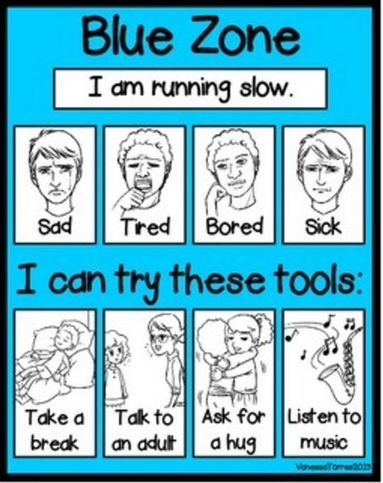
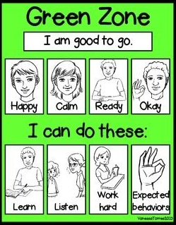

Slide 13
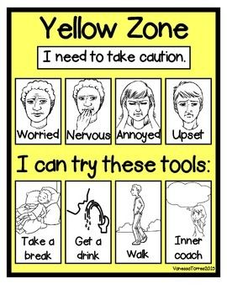
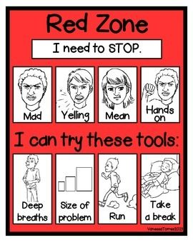

Slide 14
How can I support the Zones of Regulation at home?
Identify your own feelings using Zones language in front of your child (e.g. “I’m frustrated, I am in the yellow zone”)
Talk about what tool you will use to be in the appropriate zone (e.g. “I’m going to go for a walk, I need to get to the green zone”)
Label what zones your child is in throughout the day (e.g. “You look sleepy, are you in the blue zone?”)
Teach your child what Zones tools they can use (e.g. “It’s time for bed, let’s read a book together in the rocking chair to get to the blue zone”)
Share how their behaviour is affecting your zone (e.g. “It puts me in the blue zone when you ignore me”)
Post and reference the Zones visuals and tools in your home.

Slide 15
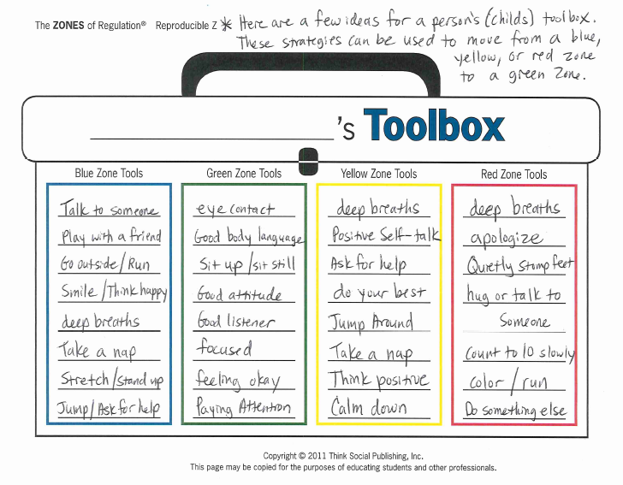

Slide 16
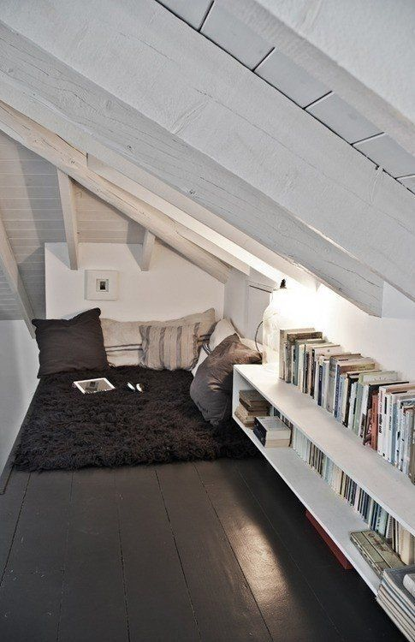
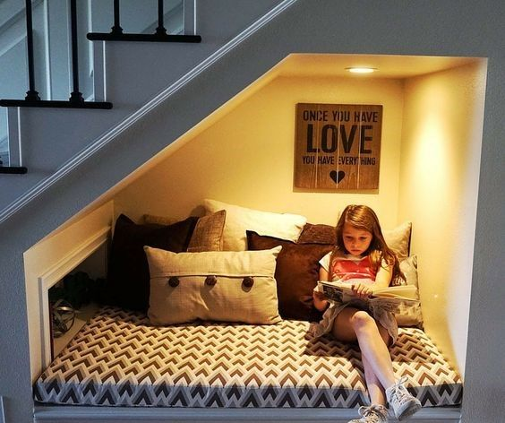
Quiet Space Sensory Room Inclusion room Relaxation station

Slide 17
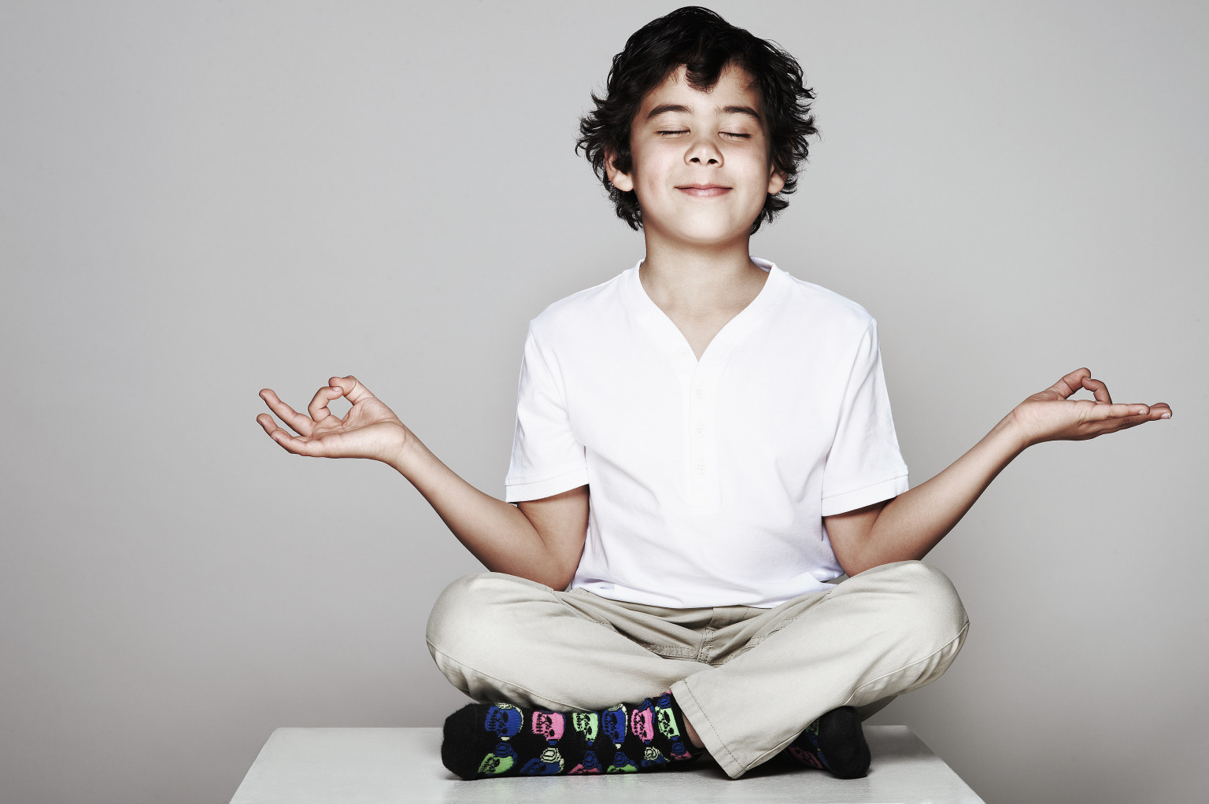
Calming techniques

Slide 18
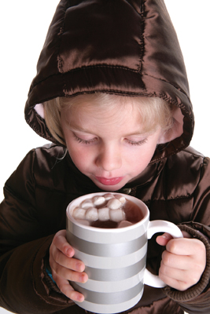
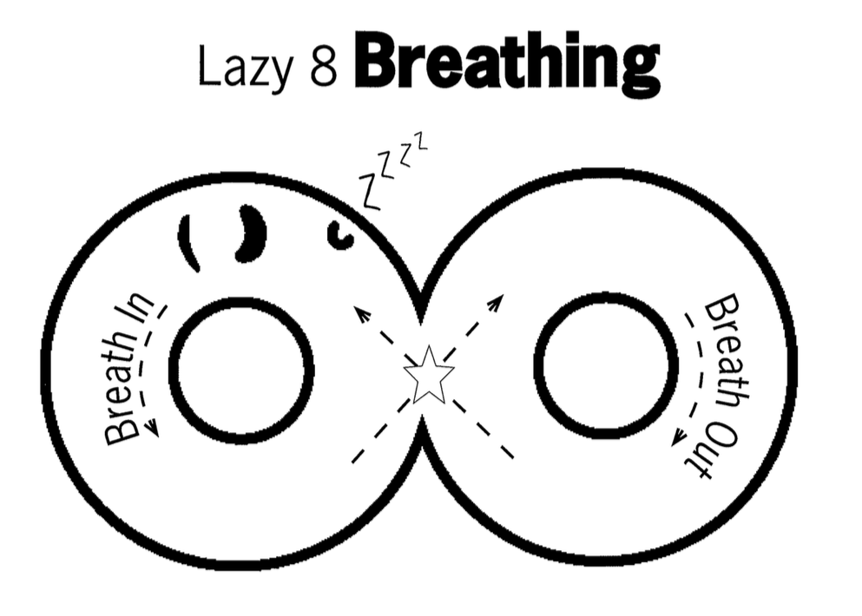
DEEP BREATHING

Slide 19

Counting
Forward and backward
Count objects
Count colors
Count breaths
Count pulse

Slide 20

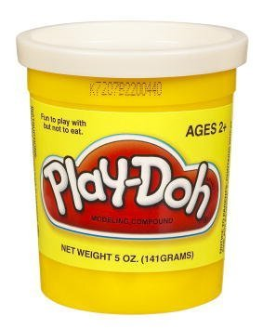

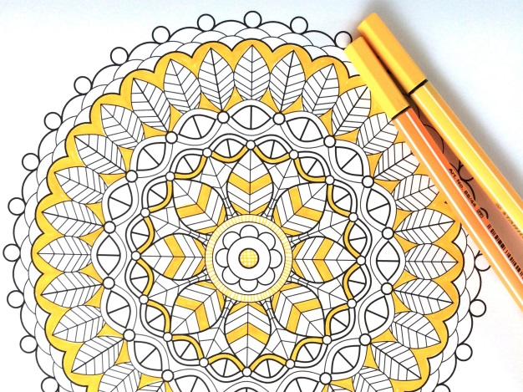
Calming Activities
Puzzles
Listen to Music
Draw/Paint
Origami
Play-Doh/clay
Read
Stack Rocks
Colouring Books with non-dominant hand

Slide 21
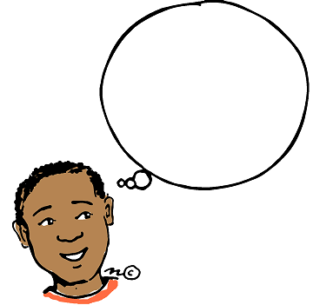
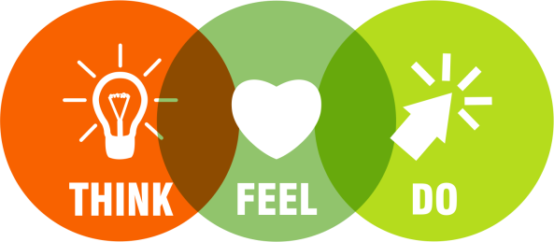
Thinking Strategies

Slide 22
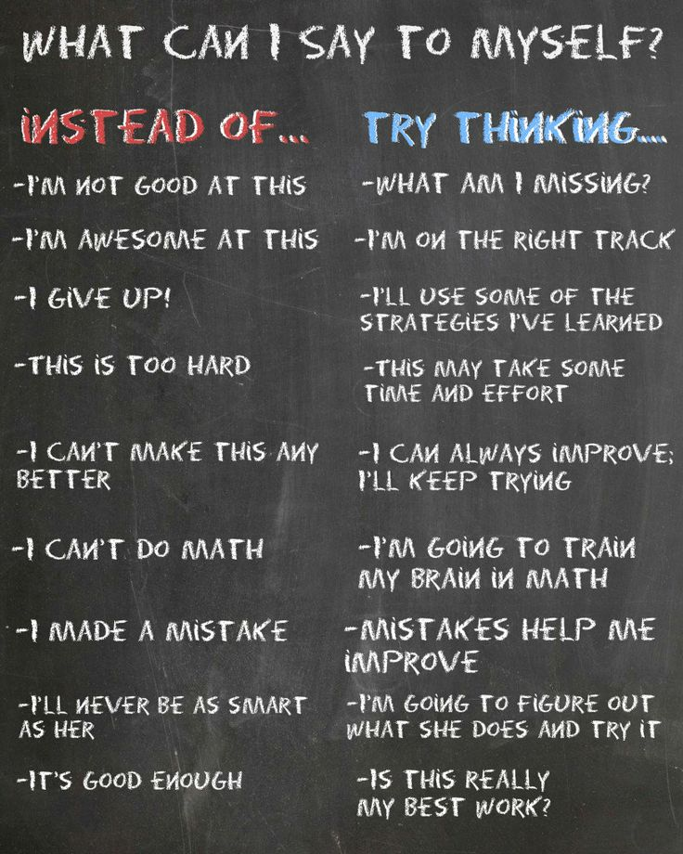

Positive Self-talk
Notes:
AKA our “inner coach”

Slide 23
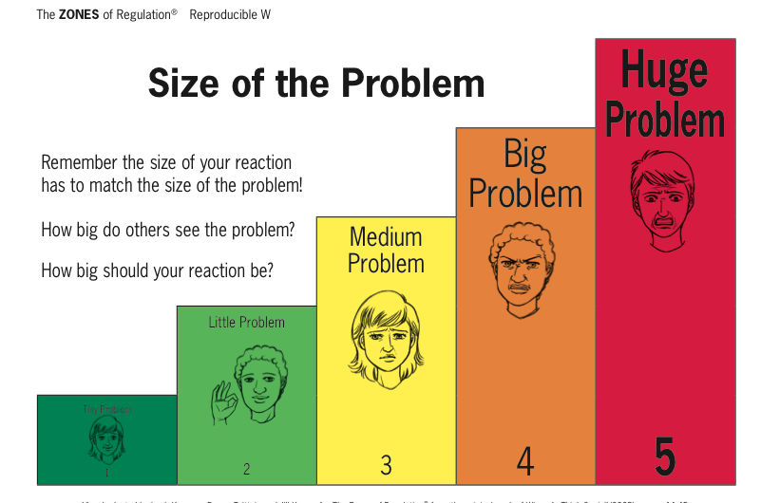

Slide 24
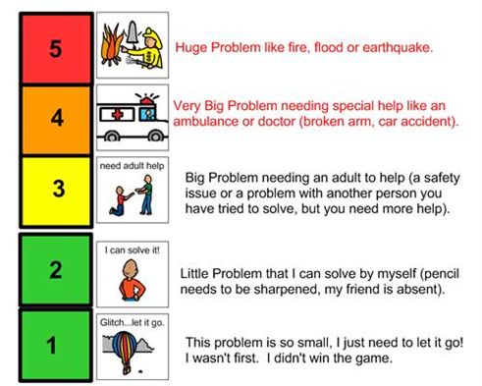
Size of the problem

Slide 25
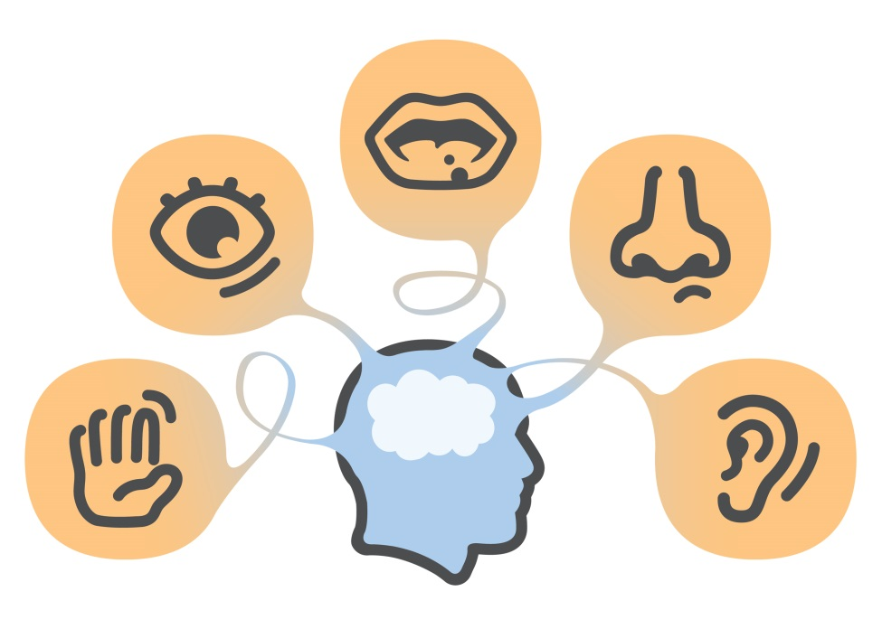
Sensory support

Slide 26
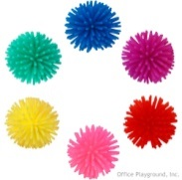
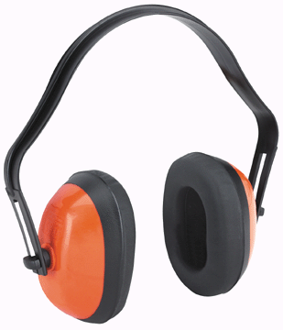
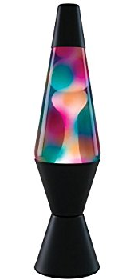
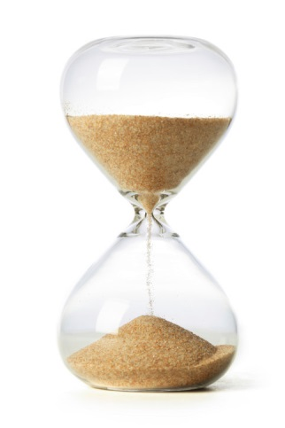
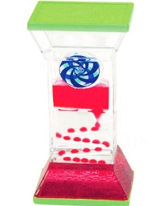

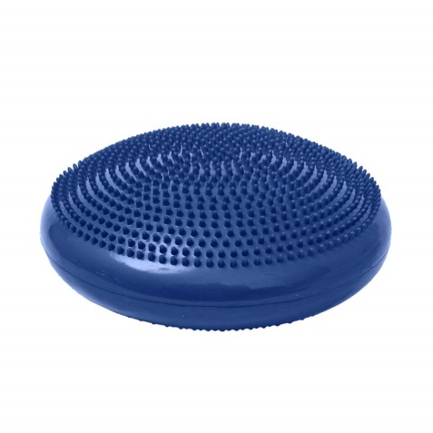
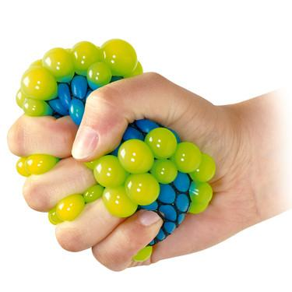

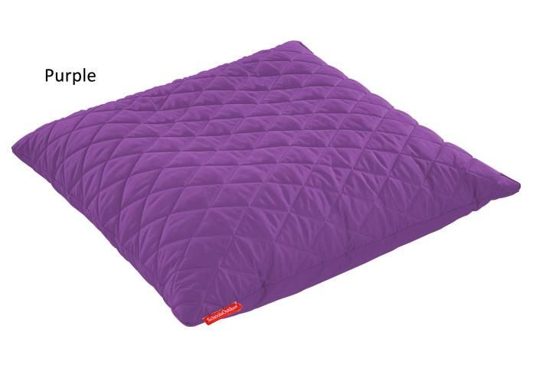
Sensory tools
Notes:
Create your own sensory shakers
Create a sensory bin
Have a IMPORTANT: Self-regulation tools should be available on an as-needed basis or at a scheduled break time. These tools should not be withheld as a consequence or used as a reward.

Slide 27
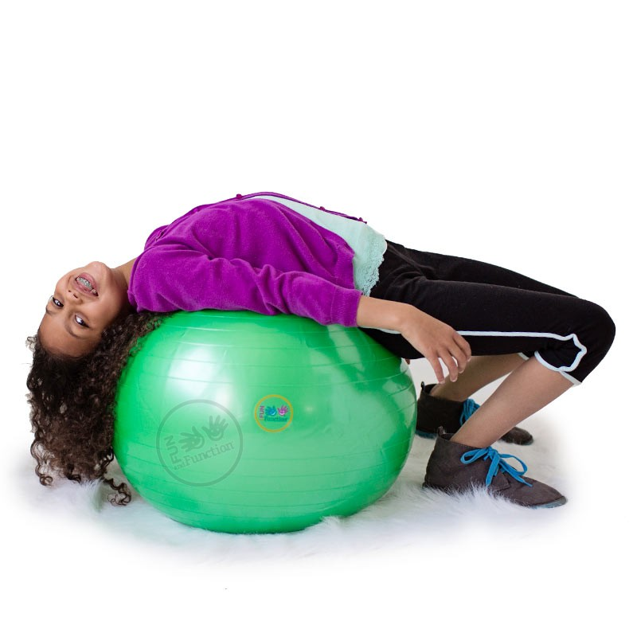


Sensory strategies
Bear Hug
Spaghetti Noodle
Swing/rock
Go for a walk
Wall push ups
Straw (breath or chew)
Blow bubbles
Classical music
Roll on an exercise ball
Trampoline
Blanket roll

