Slide 2
Order Numbers up to 10 000 000 and Determine the Value of Each Digit
Look at these numbers.
Write them in order from smallest to greatest.
8 987 390
9 543 045
8 975 434
9 678 543
4 987 390
9 543 067
4 987 390
8 975 434
8 987 390
9 543 045
9 543 067
9 678 543
Reveal Answer
When you have written them in order, explain to your partner the method you used to order them. Which ones did you find most tricky? Why?
Which of the numbers has a 6 in the tens column?
Which of the numbers has a 7 in the ten thousands column?
What would be 10 less than the number that has a 4 in the millions column?
9 543 067
Reveal Answer
8 975 434 and 9 678 543
Reveal Answer
4 987 380
Reveal Answer

Slide 3
Compare Numbers up to 10 000 000 and Determine the Value of Each Digit
Look at these numbers.
Identify whether a < or > sign needs to go in each box.
4 567 432
7 567 309
9 506 705
3 400 101
1 090 030
<
4 576 432
7 567 329
9 500 705
3 401 001
1 090 103
<
>
<
<
Compare your answers with your partner. Do you have the same?
Which ones did you find most tricky?
CHALLENGE: Choose one of the number sentences and explain to your partner which digit column helped you to identify the greater/smaller number.

Slide 4

Round Any Whole Number to a Required Degree of Accuracy
2876 + 1325
Estimate the answer to this question by:
Rounding to the nearest 1000
Rounding to the nearest 100
Rounding to the nearest 50
Rounding to the nearest 10
3000 + 1000 = 4000
2900 + 1300 = 4200
2900 + 1350 = 4250
2880 + 1330 = 4210
Reveal Answer
Reveal Answer
Reveal Answer
Reveal Answer
Which estimate do you think will be closest to the correct answer? Why?

Slide 5

Use Negative Numbers and Calculate Intervals across Zero
A diver records some of his finds in this table:
Object | Depth
Shipwreck | -13m
Stingray | -5m
Another Diver | 2m above the shipwreck
Barracuda | 2m lower than the stingray
Work with a partner to discuss the following:
Which object is the deepest? How do you know?
Which is higher, the other diver or the barracuda? How do you know?
A man is standing on the top deck of a boat that is on the water. The man is 2 metres above the surface of the sea. How far apart is he from the stingray?
Shipwreck
Reveal Answer
Barracuda
Reveal Answer
7m
Reveal Answer
Challenge: What other question could be asked about the details in the table?

Slide 6

Solve Problems Involving Addition, Subtraction, Multiplication and Division
1823
Target Number:
Can you make the number above using any of the following?
Each number may only be used once.
100
4
5
7
32
10
25
30
Try different ways of doing this until you are as close to the number as you can be.
Is there more than one way of reaching the target number?
Possible Answer:
(100 × 10) + (32 × 25) + (30 - 7)
1000 + 800 + 23
1823
Reveal Possible Answer

Slide 7

Identify Common Factors
Find all the factors of these numbers:
6
9
12
15
18
30
1,2,3,6
1,3,9
1,2,3,4,6,12
1,3,5,15
1,2,3,6,9,18
1,2,3,5,6,10,15,30
Reveal Answer
Reveal Answer
Reveal Answer
Reveal Answer
Reveal Answer
Reveal Answer
Challenge: Choose two of the numbers above and write the common factors of them both.

Slide 8

Identify Common Multiples
Find the first 10 multiples of these numbers:
3
4
6
7
9
3,6,9,12,15,18,21,24,27,30
4,8,12,16,20,24,28,32,36,40
6,12,18,24,30,36,42,48,54,60
7,14,21,28,35,42,49,56,63,70
9,18,27,36,45,54,63,72,81,90
Reveal Answer
Reveal Answer
Reveal Answer
Reveal Answer
Reveal Answer
Challenge: Choose two of the numbers above and write the common multiples of them both.
Can you then identify the lowest common multiple (LCM) of the two numbers. When complete, pick two more numbers to find the LCM of.

Slide 9
Identify Prime Numbers
Look at the 100 square and write down the prime numbers that you see on it:
1 | 2 | 3 | 4 | 5 | 6 | 7 | 8 | 9 | 10
11 | 12 | 13 | 14 | 15 | 16 | 17 | 18 | 19 | 20
21 | 22 | 23 | 24 | 25 | 26 | 27 | 28 | 29 | 30
31 | 32 | 33 | 34 | 35 | 36 | 37 | 38 | 39 | 40
41 | 42 | 43 | 44 | 45 | 46 | 47 | 48 | 49 | 50
51 | 52 | 53 | 54 | 55 | 56 | 57 | 58 | 59 | 60
61 | 62 | 63 | 64 | 65 | 66 | 67 | 68 | 69 | 70
71 | 72 | 73 | 74 | 75 | 76 | 77 | 78 | 79 | 80
81 | 872 | 83 | 84 | 85 | 86 | 87 | 88 | 89 | 90
91 | 92 | 93 | 94 | 95 | 96 | 97 | 98 | 99 | 100
With your partner, come up with a simple definition of a prime number to share with the class.
Can you find all of the square numbers on the grid?
Can you identify the cube numbers on the grid?
prime
square
cube
Next Slide

Slide 10
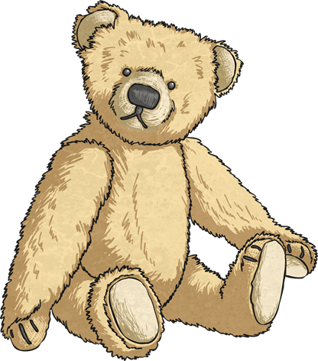
Solve Addition and Subtraction Multi-Step Problems in Context
A toyshop sells different sizes of cuddly toys – small, medium and large.
Freya buys a medium and a large cuddly toy and spends £9.25.
Oscar buys a small and a large cuddly toy and spends £8.74.
Asher buys 2 medium cuddly toys and spends £7.00.
How much does:
A small cuddly toy cost?
A medium cuddly toy cost?
A large cuddly toy cost?
£2.99
Reveal Answer
£3.50
Reveal Answer
£5.75
Reveal Answer
When you have worked out the answers, share with a partner and compare. Explain your reasoning to your partner.
Challenge: Make up a similar word problem for your friend to solve and swap so that you have to solve theirs and they solve yours.

Slide 11

Carry out Calculations Involving the Four Operations
A sweetshop sells the following items:
Boxes of chocolates: £3.49
Bags of 100g sweets: £1.10
Lollipops: 25p each
Amir wants to buy 3 boxes of chocolates, 3 bags of 100g sweets and 7 lollipops.
She has £16 in cash. How much change will she receive?
(£3.49 × 3) + (£1.10 × 3) + (25p × 7)
£10.47 + £3.30 + £1.75 = £15.52
£16.00 - £15.52 = 48p
Reveal Answer
She decides to give ¾ of her change to the charity box – how much change does she give to charity?
¼ = 48p ÷ 4 = 12p
¾ = 3 x 12p = 36p
Reveal Answer

Slide 12
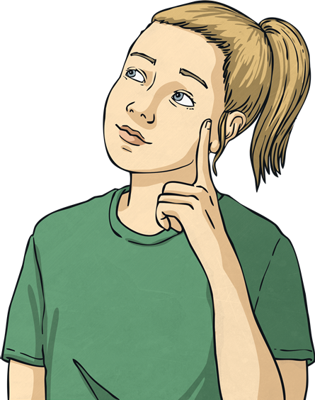
Solve Problems Involving Addition and Subtraction
Fill in the blanks to complete these number sentences:
3456 + = 7654
1308 + = 5406
2598 – 1409 =
8549 – = 3096
+ 6421 = 7104
8543 – = 1407
4198
4098
1189
5453
683
7136
With a partner, discuss:
How did you solve each question? Which did you find most difficult?

Slide 13
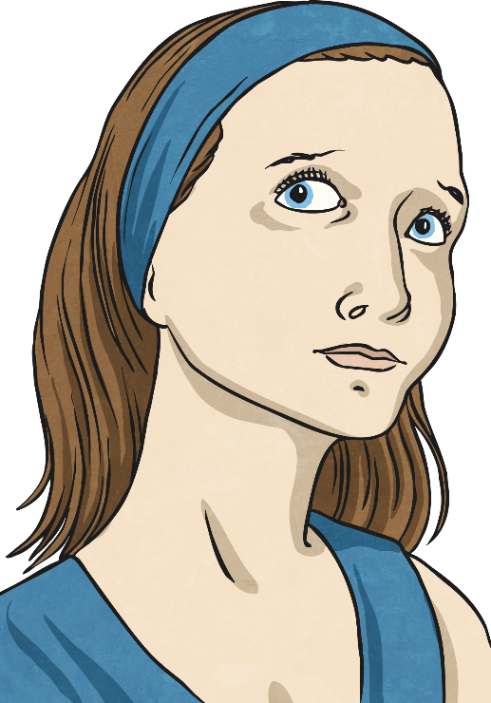
Solve Problems Involving Multiplication and Division
Fill in the blanks to complete these number sentences:
45 × = 405
380 × = 1520
355 × = 1775
900 ÷ 3 =
1500 ÷ = 250
960 ÷ = 120
9
4
5
300
6
8
With a partner, discuss:
How did you solve each question? Which did you find most difficult?

Slide 14
Describe Linear Number Sequences
Work out the steps of these linear number sequences.
When you have, work out the missing two numbers:
2 | 6 | 10 | 14 | 18
2 | 9 |  | 23 | 30 | 37
82 | 77 |  | 67 | 62 | 57
5 | 20 | 35 |  |  | 80 | 95
+ 4
22
26
16
44
+ 7
72
52
- 5
50
65
+ 15
Describe to your partner what a linear sequence is.
A linear number sequence is a sequence that increases or decreases by the same amount.
Reveal Answer
Challenge: Create your own linear sequence for your partner to complete by writing it out with two blank boxes. How complex can you make your sequence?

Slide 15
Express Missing Number Problems Algebraically
 | n
n + 15 = 41
43 – n = 11
n + 32 = 66
98 – n = 43
406 – n = 118
26
26
32
34
Work out ‘n’ in each of these algebraic expressions:
32
34
55
288
Write an algebraic expression to show each of these calculations.
A number added to 15 equals 75.
65 less than a number is 14.
38 less than a number is 54.
n + 15 = 75 n = 60
n - 65 = 14 n = 79
n - 38 = 54 n = 92
When you have written these expressions, try and solve them to find out what ‘n’ is.

Slide 16
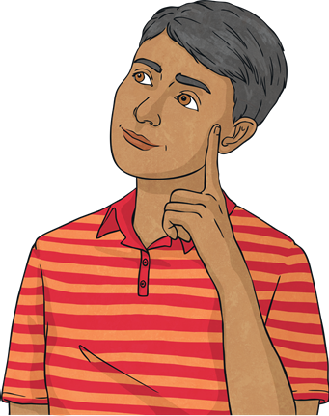
Find Pairs of Numbers That Satisfy an Equation with Two Unknowns
Find all the possible pairs of numbers that make these calculations correct:
a + b = 18
(1, 17) (2, 16) (3, 15) (4, 14) (5, 13)
Reveal Answer
(6, 12) (7, 11) (8, 10)
cd = 36
(1, 36) (2,18) (3, 12) (4, 9) (6,6)
Reveal Answer
l - m = 4
(Find 5 pairs of numbers for this one - there are lots to choose from!)
When you have written your pairs of numbers, share them with a partner.
Have either of you missed any possibilities?
Explain to each other how you found the pairs of numbers.

Slide 17
Use Common Factors to Simplify Fractions
Write factors for these numbers. Can you see any common factors?
6
9
12
1, 2, 3, 6
1, 3, 9
1, 2, 3, 4, 6, 12
1, 2, 3, 6
1, 3, 9
1, 2, 3, 4, 6, 12
16
20
36
1, 2, 4, 8, 16
1, 2, 4, 5, 10, 20
1, 2, 3, 4, 6, 9, 12, 18, 36
1, 2, 4, 8, 16
1, 2, 4, 5, 10, 20
1, 2, 3, 4, 6, 9, 12, 18, 36
Use your factor knowledge to simplify the following fractions:
12
4
15
Common Factor: 3
5
6
Challenge: Write 3 of your own fractions that can be simplified using common factors. Swap with a partner for them to solve.
1
24
Common Factor: 6
4
12
Common Factor: 12
1
36
3
24
Common Factor: 12
2
36
3

Slide 18
Compare and Order Fractions
Which fraction is greater in each pair?
3
4
4
9
or
8
Reveal Answer
8
7
9
9
3
or
2
Reveal Answer
2
3
18
18
4
or
20
Reveal Answer
20
5
9
5
7
or
14
Reveal Answer
7
2
29
29
3
or
36
Reveal Answer
36
Explain to a partner how you worked out each fraction.
Did you both reach your answer in the same way?

Slide 19
Add and Subtract Fractions with Different Denominators
For each pair of fractions, find the ‘lowest common denominator’ and complete the calculation:
1
+
1
3
+
2
=
5
2
3
=
6
Reveal Answer
6
6
4
+
2
36
+
10
=
46
or
1
5
9
=
45
45
45
1
Reveal Answer
45
2
+
4
10
+
12
=
22
or
7
3
5
=
15
Reveal Answer
1
15
15
15
3
+
7
9
+
14
=
23
or
5
6
9
=
18
Reveal Answer
1
18
18
18
Compare your calculations with a partner.
Do you have the same answer? Can you explain how you worked it out?

Slide 20
Add and Subtract Fractions with Different Denominators
For each pair of fractions, find the ‘lowest common denominator’ and complete the calculation:
3
-
8
15
-
8
=
7
4
20
=
20
Reveal Answer
20
20
2
-
1
8
-
5
=
3
5
4
=
20
20
20
Reveal Answer
3
-
4
21
-
16
=
5
4
7
=
28
Reveal Answer
28
28
8
-
5
24
-
20
=
4
=
1
12
9
=
36
Reveal Answer
36
36
9
Compare your calculations with a partner.
Do you have the same answer? Can you explain how you worked it out?

Slide 21
Multiply Simple Pairs of Proper Fractions, Writing the Answer in Its Simplest Form
For each pair of fractions, find the ‘lowest common denominator’ and complete the calculation:
3
3
3 × 3 = 9
9
×
=
Reveal Answer
=
4
4
4 × 4 = 16
16
2
×
1
2 × 1 = 2
=
2
=
1
5
6
=
Reveal Answer
30
15
5 × 6 = 30
7
×
4
7 × 4 = 28
=
28
=
7
=
1
8
7
=
Reveal Answer
56
14
2
8 × 7 = 56
8
2
8 × 2 = 16
16
4
×
=
Reveal Answer
=
=
12
9
12 × 9 = 108
108
27
How would you tell a partner to solve these problems?

Slide 22
Divide Proper Fractions by Whole Numbers
When you divide a fraction by a whole number, you have to multiply the fraction’s denominator by the whole number. Don’t forget to write your answer in its simplest form.
5
÷
2
5
5
÷
6
5
6
=
Reveal Answer
=
Reveal Answer
12
12
72
7
7
1
÷
7
1
÷
5
=
Reveal Answer
4
=
Reveal Answer
9
45
28
Compare your answers with a partner. Can you explain to each other how you carried out each calculation?

Slide 23
Identify the Value of Each Digit in Numbers Given to Three Decimal Places
5
3
1 657 043.867
1
7
0
4
8
6
Write the number in words.
One million, six hundred and fifty-seven thousand and forty-three point eight, six, seven.
Reveal Answer
Name the digit that is in the:
- hundred column,
- tenths column,
- ten thousands column,
- millions column,
Reveal Answer
- tens column,
- hundredths column,
- thousands column,
- ones column.
Reveal Answer
Reveal Answer
Reveal Answer
Reveal Answer
Reveal Answer
Reveal Answer
Reveal Answer
Give a partner 10 digits to work with.
What is the greatest number that they can make? What is the smallest?

Slide 24
Multiply and Divide Numbers by 10, 100 and 1000 Giving Answers to 3 Decimal Places
Can you complete the table below?
÷ 1000 | ÷ 100 | ÷ 10 |  | × 10 | × 100 | × 1000
 |  |  | 34
 |  |  | 506
 |  |  | 7049
 |  |  | 12 305
Challenge: Can you describe what is happening to the number in each calculation?

Slide 25
Use Equivalences between Simple Fractions, Decimals and Percentages
Look at the fractions, decimals and percentages and match them in groups of 3 that are equivalent to make a happy family!
50%
0.25
1.0
½
10%
100%
0.75
0.4
1
40%
10
¼
75%
25%
0.5
¾
1
4
0.1
10
Click on a number to check
Next Slide

Slide 26

Convert between Miles and Kilometres
Using the approximation that 5 miles = 8 kilometres, convert each of these into either miles or kilometres:
Miles | Kilometres
15
 | 40
20
 | 48
50
 | 2
100
 | 20
7.5
 | 60
24
25
32
30
80
1.25
160
12.5
12
37.5
Share your answers with a partner. Do you have the same answers? Discuss how you completed the calculations.

Slide 27
Recognise That Shapes with the Same Area…
Work out the area and perimeter of these shapes…
5cm
4cm
A
B
C
10cm
Area:
4cm x 5cm = 20cm²
12cm x 5cm = 60cm²
20cm² + 60cm² = 80cm²
Area: 10cm x 8cm = 80cm²
Area: 16cm x 5cm = 80cm²
8cm
Perimeter:
10cm + 10cm + 8cm + 8cm = 36cm
10cm
16cm
Perimeter:
12cm + 10cm + 4cm + 5cm + 8cm +5cm = 44cm
5cm
Perimeter:
16cm + 16cm + 5cm + 5cm = 42cm
Show Answers
12cm
A
B
C
Area
Area
Area
Perimeter
Perimeter
Perimeter
What do you notice about the area and perimeter of each shape?
Can you complete the half-written objective at the top of the slide?
Challenge: How many other ways could the area of shape C be calculated?
…Can Have Different Perimeters

Slide 28
Calculate the Area of Triangles
Calculate the area of each triangle.
B
A
4cm
16cm ÷ 2cm = 8cm
8cm x 4cm = 32cm²
16cm
C
7cm
9cm ÷ 2cm = 4.5cm
4.5cm x 7cm = 31.5cm²
7cm
9cm
12cm
Show Answers
12cm ÷ 2cm = 6cm
6cm x 7cm = 42cm²
A
B
C
Area
Area
Area
Challenge: A triangle has a base of 13cm and an area of 71.5cm². What is its height?
13cm ÷ 2cm = 6.5cm
6.5cm x cm = 71.5cm²
71.5cm² ÷ 6.5cm = 11cm

Slide 29
Calculate the Area of Parallelograms
Calculate the area of each parallelogram.
A
B
4cm
9cm
22cm
22cm x 4cm = 88cm²
14cm
14cm x 9cm = 126cm²
D
C
Show Answers
11cm
7cm
9cm
A
B
9cm x 7cm = 63cm²
C
D
21cm
21cm x 11cm = 242cm²
Challenge: A parallelogram has a height of 25cm and an area of 450cm². What is the length of its base?
cm x 25cm = 450cm²
450cm² ÷ 25cm = 18cm

Slide 30
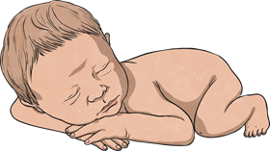
Calculate the Mean as an Average
A hospital keeps records of babies' birth weights over a weekend.
Baby A | Baby B | Baby C | Baby D | Baby E
1.8kg | 2.2kg | 3.5kg | 2.4kg | 2.1kg
What is the mean weight of the babies born over the weekend?
2.4kg
Reveal Answer
How did you calculate the average?
Were there any of the weights that have made a big difference to the average? How do you know?
Challenge: If two more babies were born that week, how does their data affect the average? Give your answer to 2 decimal places.
Baby F | Baby G
2.6kg | 2.4kg
2.43kg
Reveal Answer

Slide 31
Solve Problems Involving the Calculation of Percentages
Solve the following problems:
In a year group of 50 children there are 21 girls.
What percentage of the pupils are boys?
21
=
42
42% are girls, so 58% are boys.
50
Reveal Answer
100
In a bag of 25 marbles there are two colours (red and yellow). 6 marbles are red, the rest are yellow.
What percentage of the marbles are yellow?
6
24
24% are red, so 76% are yellow
25
=
Reveal Answer
100
In a school, 40% of the children are girls. There are 80 girls.
How many children are in the school in total?
Girls: 40% = 80 Boys: 60% = (80 ÷ 4) × 6 = 120
80 girls + 120 boys = 200 children
Reveal Answer
Challenge: If you were explaining how you solved each problem to a friend, what would you say was the most efficient calculation?

